Slide 1
Motivation
Contemporary developments in computer vision and artificial intelligence show promise to greatly improve the lives of those with disabilities.
Blindness or vision impairment, one of the top ten disabilities among men and women.
A-cording to the World Health Organization, 285 million people around the world live with moderate to severe vision impairment.
Accessible visual information is of paramount importance to improve independence and there is a pressing need to develop smart automated systems to assist their navigation, specifically in unfamiliar healthcare environments, such as clinics, hospitals, and urgent cares.

Slide 2
Objective
We propose one such development: An object recognition model for wearable object recognition device.
Our algorithm is specialized to recognize items from the produce section of a grocery store.
We propose to develop the model in such a way that the accuracy is higher than the other existing models.

Slide 3
Literature survey

Slide 4
Sl.No | Author & Year of Publication | Journal | Title of the paper | Advantage(s) | Limitation(s)
1. | C. M. Mangione, S. Berry, K.Spritzer, N. K. Janz, R. Klein,C. Owsley, and P. P. Lee | IEEE | Archives of Ophthalmology | The objective of the Archives of Ophthalmology is education: To inform its readers of progress, problems, and pertinent research in the practice of ophthalmology through the publication of original contributions and observations | Archives of Ophthalmology and Optometry is an international, open access, online publishing, medical journal that covers the full spectrum of Ophthalmology and Optometry
2. | G. Bebis, D.Egbert and M.Shah | IEEE | Review of computer vision education | Vision is perhaps the most important of the human senses. It provides us, seemingly effortlessly, with a detailed three dimensional description of a complex and rapidly changing world. | During the past ten years, computer vision has grown from a research area to a widely accepted technology, capable of providing a dramatic increase in productivity and improving living standards.
3. | J. Schmidhuber | IEEE | Deep learning in neural networks | Artificial intelligence (AI), deep learning, and neural networks represent incredibly exciting and powerful machine learning-based techniques used to solve many real-world problems. | The primary motivation and driving force for these areas of study, and for developing these techniques further, is that the solutions required to solve certain problems are incredibly complicated, not well understood, nor easy to determine manually. Increasingly,
4. | K. Thakoor, S. Marat, P.Nasiatka, B. McIntosh, F. Sahin, A. Tanguay, J. Weiland, and L. Itti | IEEE | A neutrally inspired object recognition algorithm for a wearable aid for the visually impaired | Humans recognize objects effortlessly, in spite of changes in scale, position, and illumination. Emulating human recognition in machines remains a challenge. | Testing on images containing 5 different objects exhibits accuracies ranging from 80% to 100%. .
5. | R. Kumar and S. Meher | IEEE | Accelerating convolution neural network with fft on tiny cores | FueXeA by ILSVRC and COCO competitions, Convolution Neural Network (CNN) has become important in computer vision, and natural language processing. | Results are evaluated and compared with respect to throughput per watt, energy delay product, and execution time for three methods.

Slide 5
Sl.No | Author & Year of Publication | Journal | Title of the paper | Advantage(s) | Limitation(s)
6. | R. Ahn and J. Zhan | IEEE | A novel method for visually impaired using object recognition | With the advancement in computer vision and computing technologies we can afford to develop a system for visually impaired people, which can give audio feedback of surrounding objects and context. | .The algorithm is evaluated on an online dataset as well as on our dataset.
7. | J. Wang, J. Zhang, and J. Zhan | IEEE | A mobile app for object recognition for the visually impaired | The blind and the visually impaired face diverse kinds of life challenges that normally sighted people take for granted. | In this communication we report a solution aimed at aiding the visually impaired in colour detection, light direction detection and recognition of objects.
8. | M. Wu, J. Zhan, and J. Lin | IEEE | Deep learning for link prediction in dynamic networks using weak estimators | Recent research has focused on extending link prediction to a dynamic setting, predicting the creation and destruction of links in networks that evolve over time. | Weak estimators have been used in a variety of machine learning algorithms to improve model accuracy, owing to their capacity to estimate changing probabilities in dynamic systems.
9. | J. Zhan and B. Daha | IEEE | Using empirical recurrences rates ratio for time series data similarity | In the modern age, the necessity to construct efficient tools to classify and categorize time series instances is undeniable. | As Liao narrates, several application domains have witnessed such clustering exercises over the years.
10. | J. Zhan, S. Gurung, and S. P. K. Pars | IEEE | A weak estimator for dynamic systems | While the nature of expected observations sufficiently guides the former, subject matter and inside knowledge are usually the only tools to check the latter. | The relationship of the underlying Bernoulli distribution with the flow of time is thus not static: it evolves with it.

Slide 6
Software Requirements
Python 3.0
TensorFlow
Keras
Google colab
OpenCV (Open Source Computer Vision Library)

Slide 7
Algorithm
The majority of the previously developed algorithms make use of computer vision, an emerging technology.
Among the major sub domains of computer vision include object recognition and image restoration, and its applications overlap significantly with machine learning.
First we use Naive Bayes method for classification of the product.
The algorithms that can be use are:
YOLO(you only look once)
Single Shot algorithm
R-CNN

Slide 8
YOLO – You only look once
YOLO is a clever convolutional neural network (CNN) for doing object detection in real-time
The algorithm applies a single neural network to the full image, and then divides the image into regions and predicts bounding boxes and probabilities for each region
These bounding boxes are weighted by the predicted probabilities

Slide 9
Single shot Detection Algorithm
It is significantly faster in speed and high-accuracy object detection algorithm
High speed and accuracy of SSD using relatively low resolution images is attributed due to following reasons
Eliminates bounding box proposals like the ones used in RCNN’s
Includes a progressively decreasing convolutional filter for predicting object categories and offsets in bounding box locations.

Slide 10
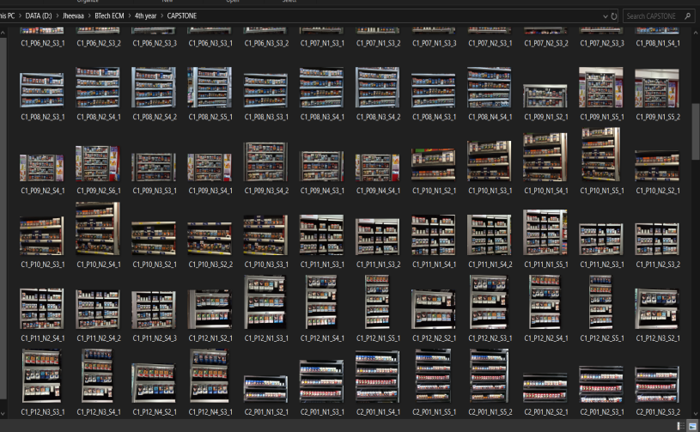
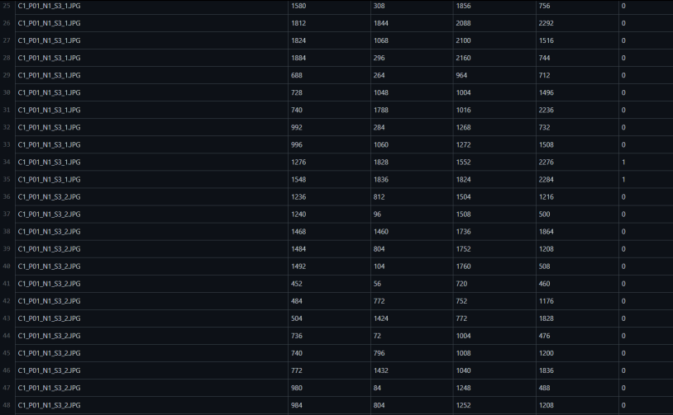
Dataset
Here we use a structured dataset with 13184 samples.
Image Dataset contains 3 types of data
Brand image
Product image
Shelf image
Dataset also contains the information about the dimentions of each product from the images.

Slide 11
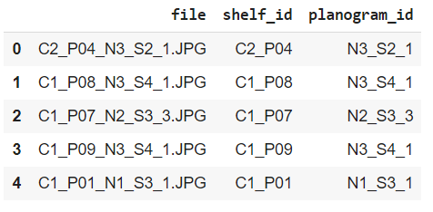
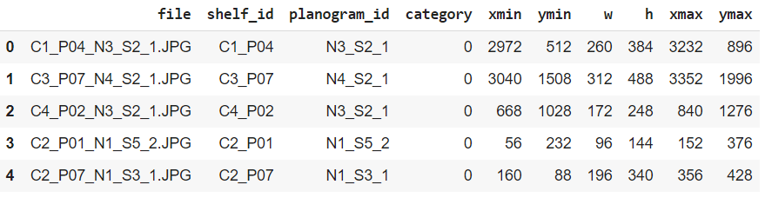
Dataset

Slide 12
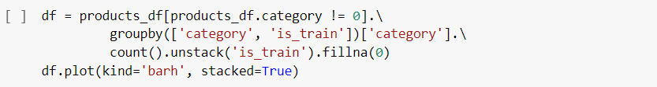
Naïve Bayes method
We use naïve bayes method to visualize how much of the data we use for training and testing

Slide 13
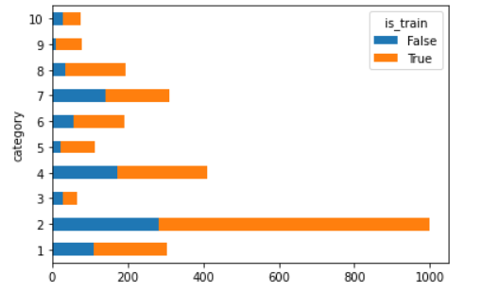
Naïve Bayes method

Slide 14
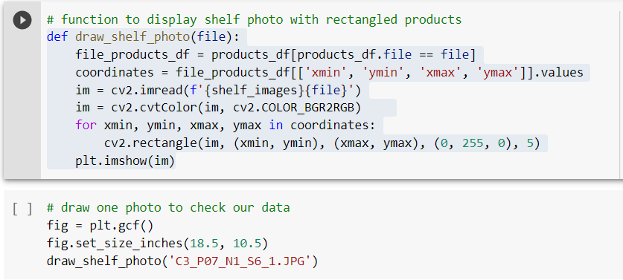
Open CV

Slide 15
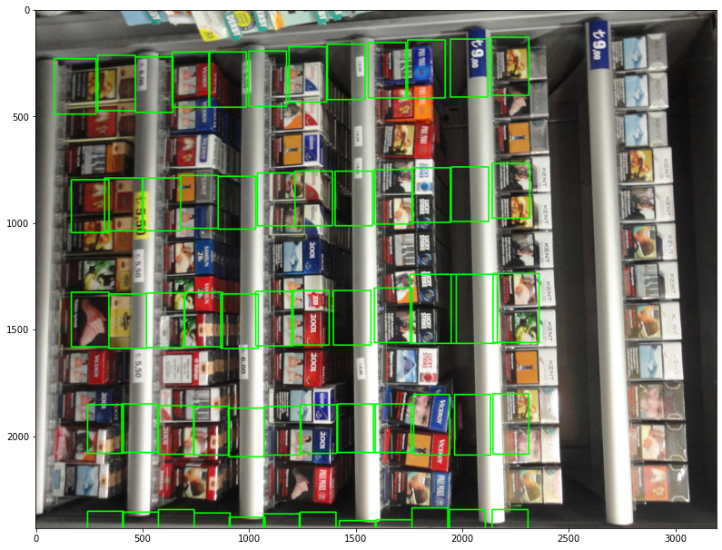
OPEN CV

Slide 16
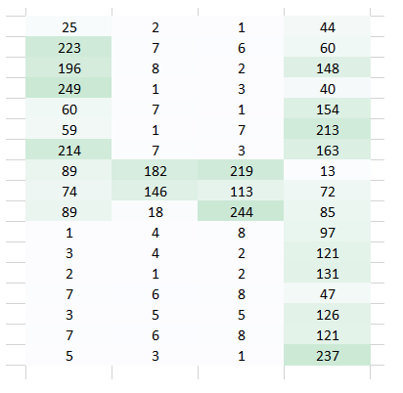
How DOES MACHINE LEARNING LOOK AT AN IMAGE

Slide 17
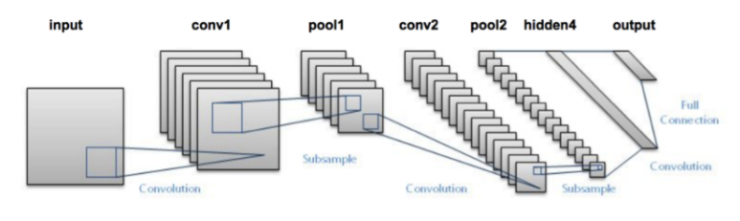
CNN:
Convolution layer : summarizes the presence of features in an input image
Pooling layers : Pooling is done for the sole purpose of reducing the spatial size of the image

Slide 18
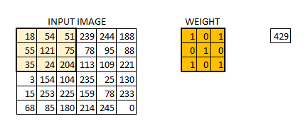
The Convolution Layer

Slide 19
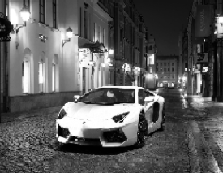
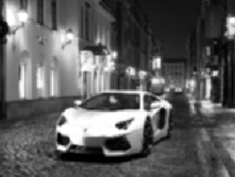
convolution
Original image
Convoluted image

Slide 20
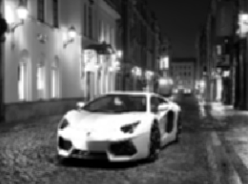
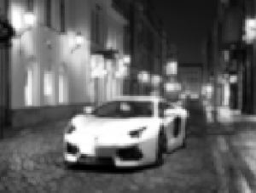
maxpooling
Convoluted image
Max pooling

Slide 21
CNN
First, we take an image as input
Then we divide the image into various regions
We will then consider each region as a separate image.
Pass all these regions (images) to the CNN and classify them into various classes.
Next is to get the Region of Interest for each image. We then reshape all these regions so that they can match the CNN input size. Once we have divided each region into its corresponding class, we can combine all these regions to get the original image with the detected objects.
we train a linear regression model to generate tighter bounding boxes for each identified object in the image.

Slide 22
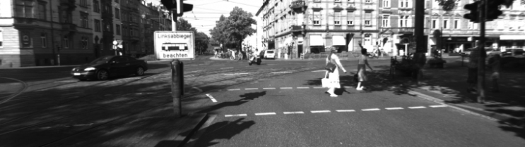
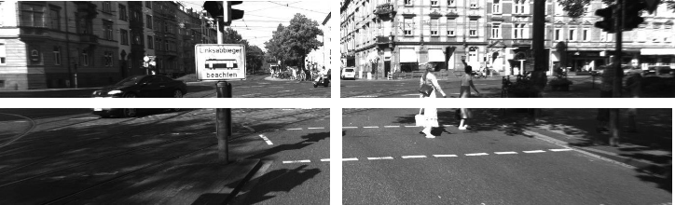
cnn

Slide 23
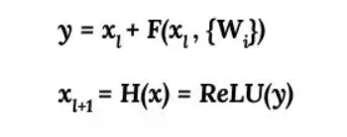
Resnet
We use normalized image for faster processing as it has the values in gaussian curve.
Algorithm
Y= Addition output.
X(l+1)=Input to next block.
Uses 16 filter layers.
One addition layer.
Activation function As RELU.
Learning rate as 0.001.
Kernel size as 3.

Slide 24
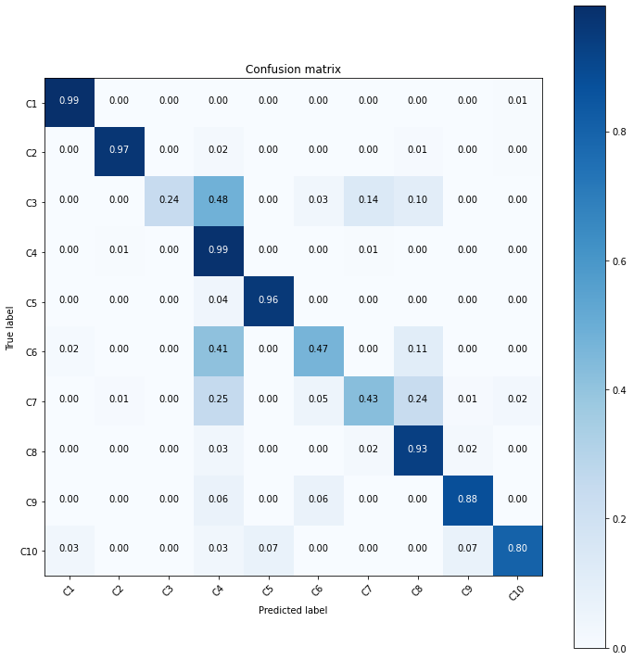
Training the dataset
Accuracy =73.3804%

Slide 25
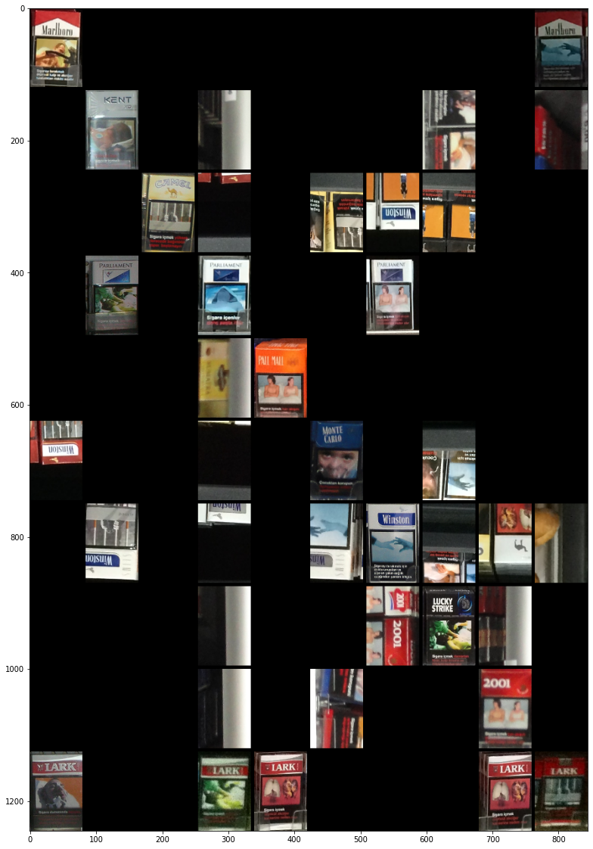
Resnet bounded output

Slide 26
Modification from the model
A Frozen inference graph is been added for further optimization.
This graph contains the probability value of the used model with more accuracy.
These values are used as the weights for the Resnet model and the output is being optimised.

Slide 27
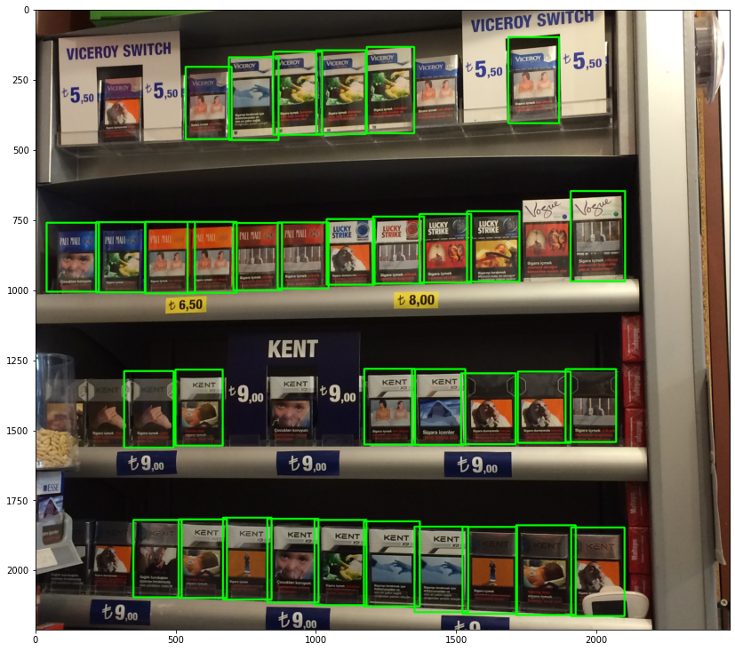
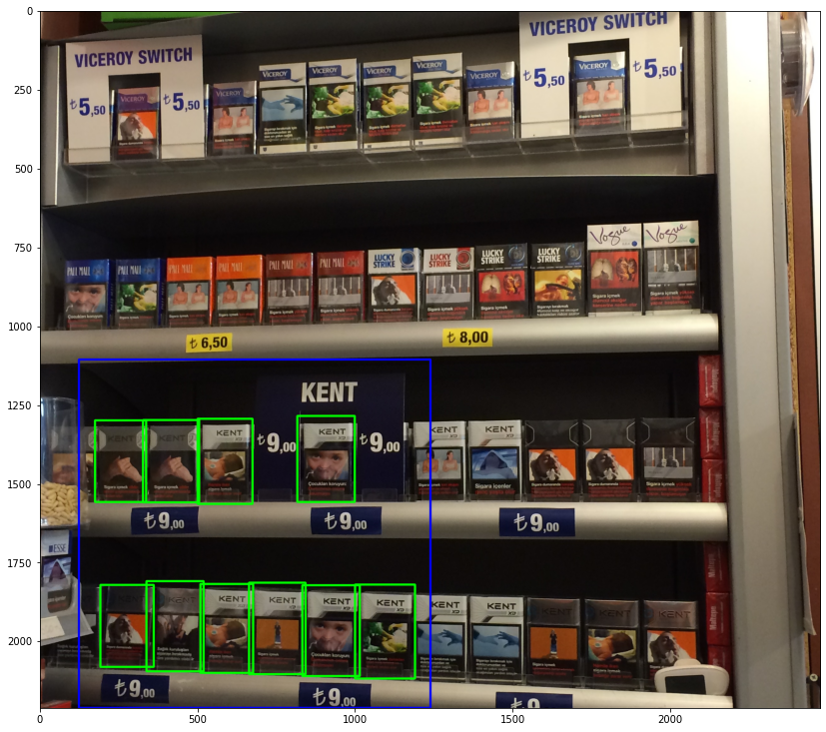
Output of modified model

Slide 28
References
Mangione CM, Berry S, Spritzer K, Janz NK, Klein R, Owsley C, Lee PP. Identifying the content area for the 51-item National Eye Institute Visual Function Questionnaire: results from focus groups with visually impaired persons. Arch Ophthalmol. 1998 Feb;116(2):227-33. doi: 10.1001/archopht.116.2.227. PMID: 9488276.
G. Bebis, D. Egbert and M. Shah, "Review of computer vision education," in IEEE Transactions on Education, vol. 46, no. 1, pp. 2-21, Feb. 2003, doi: 10.1109/TE.2002.808280.
Jürgen Schmidhuber,Deep learning in neural networks: An overview,Neural Networks,Volume 61,2015,Pages 85-117,ISSN 08936080,https://doi.org/10.1016/j.neunet.2014.09.003.
K. Thakoor, S. Marat, P. Nasiatka, B. Mcintosh, F. Sahin, A. R. Tanguay, J. D. Weiland, L. Itti, Attention-Biased Speeded-Up Robust Features (AB-SURF): A Neurally-Inspired Object Recognition Algorithm for A Wearable Aid for the Visually Impaired, In: Proc. IEEE Conference on Multimedia and Expo (ICME), Workshop on Multimodal and Alternative Perception for the Visually Impaired People (MAP4VIP), Jul 2013.

Slide 29
THANK YOU

